Slide 1

MACROECONOMICS
Lecture 03: Measuring National Income
Dr. Hemantha Premarathne
B.A. Econ & Stat (Hons) Pera, M.A. & Ph.D. (Saga, Japan)

Slide 2
Layout of the Lecture
3.1 Introduction
3.2 Some Concepts related to National Income
3.3 National Income Measures
3.4 Methods of Measuring National Income
3.5 Measurement of National Income in Sri Lanka
3.6 Merits of Measuring National Income
3.7 Limitations of Measuring National Income

Slide 3
3.1 Introduction
Macroeconomics is the study of the economy as a whole. National income (GDP/GNP) is the single most important macro variable that represents the “economy as a whole”.
All other macro variables are either the components of or are the result of national income (GDP/GNP).
From the practical point of view, a country’s national income data is used for;
measuring the standard of living and economic welfare of its people.
formulation of economic policies for the management of the economy.
making international comparisons about the status of the economy.

Slide 4
3.2 Some Concepts related to National Income
Economic & Non-Economic Production
All goods and services produced by human activities are not included in national income accounting. For this purpose, production of goods and services by human beings are classified under two categories.
Economic Production
Marketable
Non-Marketable
Goods & services produced by farmers, firms, factories, shops, hotels, lawyers.
Goods & services produced and supplied by government, public institutions, social organizations, NGOs, social service clubs, charitable societies, etc.
Government provides administrative services, law and order, national defense, etc. although they do not have a market and market price, all these services use national resources (land, labor, etc.) which have an economic cost. Therefore, production of all such goods & services falls in the category of Economic Production.

Slide 5
Cont….
Non-Economic Production
Non-economic production includes the production of goods and services that are not meant to be sold, nor is there any market for them, nor do they have a market price.
Services rendered to self, e.g. washing one’s own clothes, cooking for self, etc.
ii. Services provided to the family members, e.g. housewives cooking for the family and looking after the household, parents teaching their own children, doctors treating their own children, gardening ones own home garden.
iii. Services provided by the neighbors to each other, e.g. helping each other on festival and marriage occasion, etc.
Note:
These services are not included in the measurement of the national income as these cannot be marketed.

Slide 6
Cont….
Intermediate & Final Products
The distinction between the intermediate and final products
Ex.. Production of Sandwiches.
Wheat Producers (Farmers)
Wheat Flour (mills)
Intermediate Products
Bread (Bakery)
Sandwiches (Restaurant)
Final Product
Intermediate Product – The goods that flow from one stage to another in the process of production of a good, with their form changing, are called intermediate product.
Final Product – The goods that reach the final stage of production and flow to their ultimate consumers are called Final product.

Slide 7
Intermediate & Final Products
The need for distinction between the intermediate and final products arises because of the problem of double counting.
Ex.. Production of Sandwiches.
Wheat Producers (Farmers)
Rs. 1000
Wheat Flour (mills)
Rs. 1100
Bread (Bakery)
Rs. 1500
Sandwiches (Restaurant)
Rs. 2000
In our example of sandwich production, wheat is converted into flour, wheat flour is converted into bread, and bread into sandwich.
Whet price is included in the price of flour, in the price of bread, and in the price of sandwiches. If the total value of all these products – wheat, wheat-flour, bread and sandwich – is taken into account in national income counting, wheat price would be counted four times. This is called double counting.
therefore, avoiding double counting is a necessary condition for estimating national income correctly.

Slide 8
Intermediate & Final Products
To avoid double counting, we can use value added method.
Ex.. Production of Sandwiches.
Value added
Wheat Producers (Farmers)
Rs. 1000
Rs. 1000
Wheat Flour (mills)
Rs. 1100
Rs. 100
Bread (Bakery)
Rs. 1500
Rs. 400
Sandwiches (Restaurant)
Rs. 2000
Rs. 500
The total value addition is Rs. 2000 (1000+100+400+500)
The total value addition = the value of final product
Value added = value of production - value of intermediate goods
Value added at the mill = 1100 – 1000 = 100

Slide 9
Transfer Payments
Transfer payments are the payments made by one party to the other party, without corresponding transfer of goods & services.
For example….
you gift some money to your friend.
pension for retired people.
samurdhi
Note:
Transfer payments are not taken into national income counting because such payments do not result in any addition to the total production nor do they add any additional value to the society.

Slide 10
3.3 National Income Measures
Different kind of national income measures are used in national income analysis
Gross Domestic Product (GDP)
the value of all final goods and services produced in a country during a specific period of time, generally one year.
GDP includes income earned by the foreigners in the country and excludes income earned abroad by the residents.

Slide 11
Cont…
Gross National Product (GNP)
the value of final goods and services produced by the residents in the country during a specific period of time, generally one year.
GNP = GDP + (incomes earned by the residents of a country in foreign countries) – (incomes earned by the foreigners in the country)

Slide 12
Cont…
Nominal GDP and Real GDP
The GDP estimated at current price is called Nominal GDP
The GDP estimated at constant price in a chosen (called base year) is called Real GDP
Nominal GDP can give a misleading picture of economic performance when prices are continuously rising or decreasing.
Year Quantity of Cars Price of Cars Nominal GDP (% increase)
2019 100 $10,000 $1,000,000 (--)
2020 120 $12,000 $1,440,000 (44%)
2021 130 $13,000 $1,690,000 (17.4%)
Question
  Did the real output of cars increase 44% from 2019 to 2020?

Slide 13
Cont…
Nominal GDP and Real GDP
Real GDP in Units
Production of cars
2019 -- 100
2020 -- 120 (20% increase)
2021 -- 130 (8.33% increase)

Slide 14
III. National Income Measures
Nominal GDP and Real GDP
Real GDP in 2020 $
Car Production x 2020 Prices
2019 -- 100 x $12,000 = $1,200,000
2020 -- 120 x $12,000 = $1,440,000 (20% increase)
2021 -- 130x $12,000 = $1,560,000 (8% increase)

Slide 15
Cont…
GDP Deflator
Estimating GDP at the price of the base year is not an easy task. The economists use a simple adjustment factor called GDP Deflator to eliminate the effect of rising prices on the GDP
The GDP deflator can be used to measure the rate of inflation.

Slide 16
3.4 Methods of Measuring National Income
As we know from the circular flows of income, the income generating process creates two kinds of flows,
i. Production flows, and
ii. Money flows.
Money flows can be looked upon from two angles.
i. Money flows as factor payments, and
ii. Money flows as payments for goods and services.
Given the production flows and two ways of money flows, the economists have devised three methods of measuring national income.
i. The Value Added Method
ii. Factor Income Method
iii. Expenditure Method

Slide 17
Cont..
1. Value Added Method
Value added method is used to avoid double counting, i.e., counting the value of a commodity more than once.l and services.
National income is defined as the money value of all final goods and services produced in a given period of time. The problem of double counting arises because of the problem of defining what product is final and what is considered intermediate product. lces.
For ex.. Let’s take the previous example about sandwich. Wheat is the final product for the farmer, Appuhami. But wheat is an input (raw material) for a flour mill, say, Nipuna Flour Mill. Wheat flour is the final product for Nipuna company. But wheat flour is used by the bread manufacture, Benthota Bakery, as raw material. For Benthota Bakery, bread is the final product. But bread is an input for sandwich-maker, the Perera & Sons. Now if all these products – wheat, wheat flour, bread and sandwich – are treated as final products, value of wheat will be counted at all the four stages. Two avoid this problem of double counting, we use value added method. lces.

Slide 18
Cont….
1. Value Added Method
Suppose Nipuna flour mill buys wheat for Rs. 1000 and sell the flour to bread manufacturing company, Benthota Bakery, at Rs. 1500. This means Nipuna flour mill added a value of Rs.500 to wheat. Let’s suppose that value addition includes the cost components as given below.nservices.
Value addition by Nipuna Flour Mill (Rs)
Cost of wheat (intermediate input) Transportation cost Labor charge Electricity charge Storage charge Depreciation Profit margin | 1000 50 150 100 50 50 100
Sale Price Less Cost of wheat (raw material) | 1500 1000
Value added | 500

Slide 19
Cont…..
2. Factor Income Method
In this method, the national income is treated to be equal to all the “ incomes accruing to the basic factors of production used in producing the national products”.
National Income (GDP) = Rent + Wages + Interest + Profit + Depreciation
3. Expenditure Method
The expenditure method measures national income at the final expenditure stage.
In order to estimate the aggregate expenditure, we can use the following formula.
GDP = Y = C + I + G + (X-M)

Slide 20
3.5 Measuring National Income in Sri Lanka
An economy comprises of a variety of economic activities resulting in different sources and nature of income. For systematic and reliable accounting of national income, it is essential to classify different types of economic activities and sources of income.
For the purpose of estimating national income, the Central Bank of Sri Lanka use the following sectoral classification of economy.
i. Primary Sector (Agricultural Sector)
ii. Secondary Sector (Industrial Sector)
iii. Tertiary Sector (Service Sector)
Depending on the purpose and data availability, these broad sectors of the economy are sub-classified under their sub-categories.

Slide 21
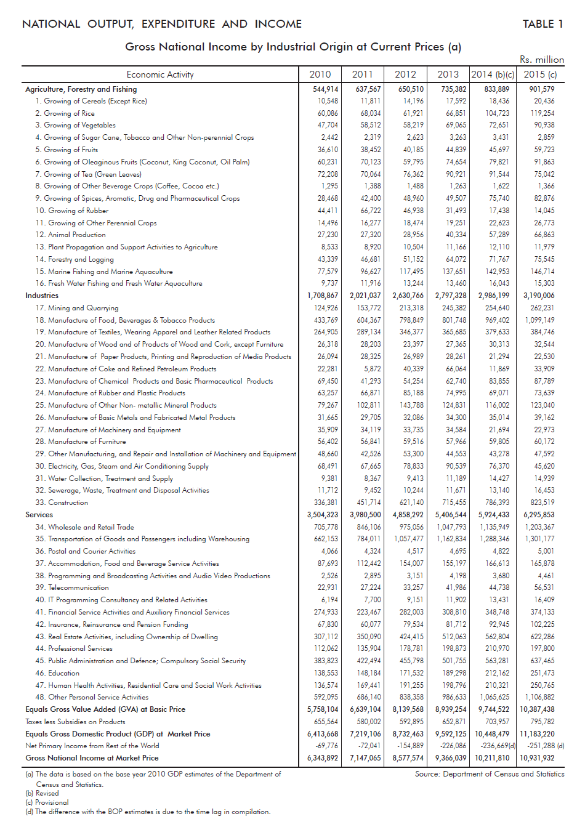
Cont…
Sub – sector classification in Sri Lanka

Slide 22
3.6 Merits of Measuring National Income
Each and every country measure national income because it gives wide range of advantages to the economy
  It helps to measure and monitor the performance of the overall economy.
  National income can used to get an idea of the welfare standard of an individual of a country (through per capita income).
  National income statistics will be useful to analyze the performance of various sectors of the economy.
  National income statistics can be used to compare the level of economy over another country as well as over another period of time.

Slide 23
Cont.
  National income statistics can be used in research and development.
  National income statistics are useful in policy evaluation and policy identification.
  National income statistics are useful in monitoring and evaluation of projects and programs at micro level as well at macro level

Slide 24
3.7 Limitations of Estimation of National Income
GDP ignores transactions that do not take place in formal
markets.
Ex. Services such as cleaning, cooking, providing free child care
that people do for themselves in their homes.
Leisure time is not included in GDP.
Leisure time is an economic good that adds to our economic
welfare. But our leisure time along with other non-market activities
is ignored in GDP accounting.
GDP ignores the underground economy, where transactions
are not reported to official authorities.
Ex.. Production and distribution of illegal drugs, using illegal labor
that is paid less than the minimum wage, jobs done for cash to
avoid paying income taxes, etc…

Slide 25
Cont….
GDP does not value the changes in environment that occur
in the production of output.
Economic activity directly influences the quality of the environment.
GDP is a qualitative rather than a quantitative measure.
It does not accurately reflect improvements in the quality of products
There can be over estimation due the wrong reports with different motives.
Survey errors (investigator mistakes) are possible
Politicization is possible.

